Slide 1
The Reuse and Evolution of Component Frameworks
A. McVeigh
16th October 2005

Slide 2
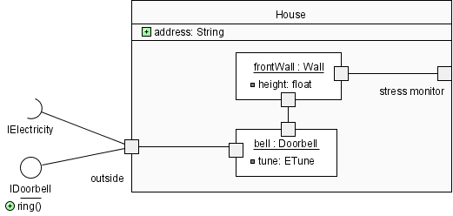
UML2 & Components
UML2 added a full ADL to the language
  Ports are a “window on a component”: provided and required interfaces
  Components are “composed” of other component instances (parts)
  Configurable properties
  A connector is a
  “wire” joining ports

Slide 3
Component Frameworks
A framework is [Booch, 2005]
  “...an extensible template for applications within a domain”
  A micro-architecture encompassing a set of mechanisms and abstractions that work together to solve a common problem for a domain
Most of the application is implemented
  to reuse, “plugin” the missing pieces

Slide 4
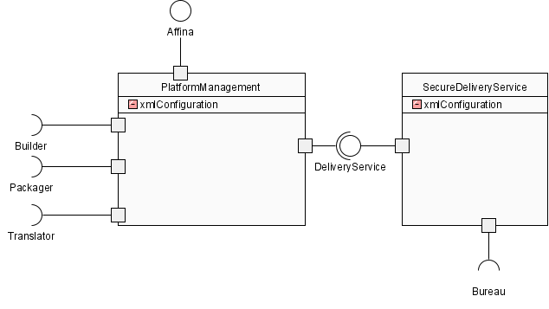
Characteristics of Frameworks
They are “active”, with control assumed
They can be phrased as components
framework(s) + configuration mechanism
= plugin architecture

Slide 5
Reuse of Frameworks
Frameworks are perhaps the largest form of reuse
Many extensible apps are built this way
  Eclipse, Firefox, IE, MagicDraw
  (From my work) Affina, CRE, TCW, TSAF
However, reuse tends to be limited by fundamental issues...

Slide 6
Problems with Reusing and Evolving Frameworks

Slide 7
Evolution Issues
A framework will be used by multiple app teams
Each app needs different framework features
  leads to code forking, or slow app delivery
  app-specific abstractions moving into framework
  “plugin hell”: plugins don’t work together...
app1
app2
app3
…..
appN
framework

Slide 8
Abstraction and Layering Issues
Frameworks are often layered on other frameworks
  The higher level frameworks use the lower-level ones
  lower-level frameworks and abstractions get “buried” & can’t be customised
  Have an “abstraction problem”
  [Greenfield, 2004]
application
framework3
framework2
framework1

Slide 9
Variability Issues
Framework is limited by the variability that has been designed in
  Usually a feature analysis is done before building, these eventually end up as some sort of “plugin” points allowing extension
  New concepts cannot be added without changing the source code of the framework
  == code fork...

Slide 10
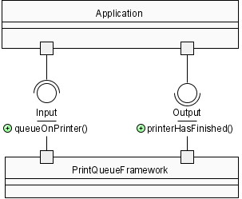
Typing & Substitution Issues
Static typing is usually needed for comprehension, but causes problems
  frameworks handle base types, but apps can’t be passed the full type back
  E.g. App passes in LaserPrinter, but gets IPrintable back!
  “Surface type” problem

Slide 11
Backbone & Component Redefinition
Addressing the Issues with Architectural Transformation Primitives

Slide 12
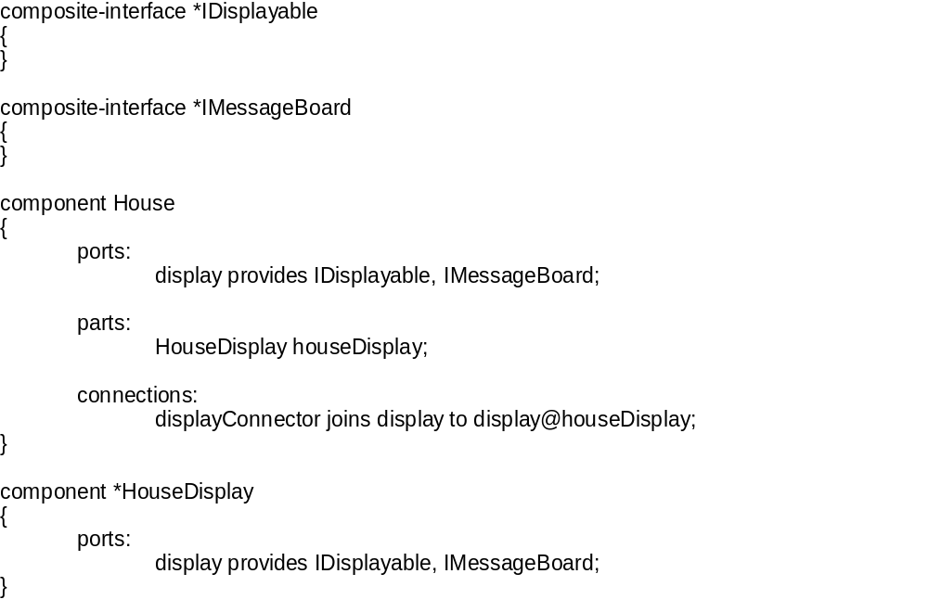
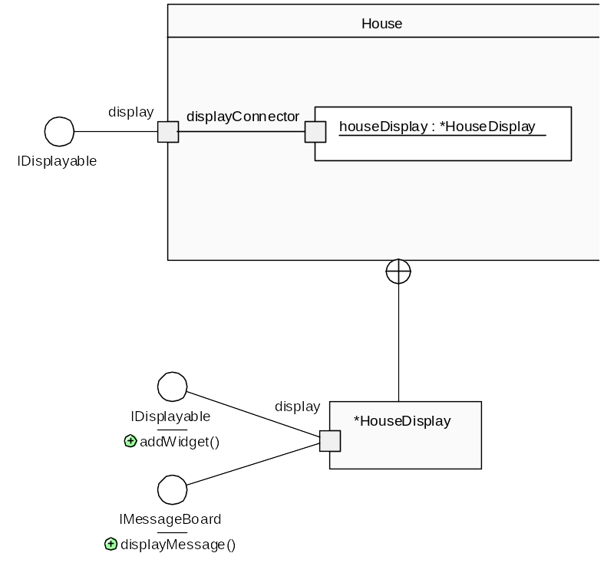
Backbone = Subset of UML2
  aim to hide text form via UML2 graphics
  NOTE: all features are explicitly named

Slide 13
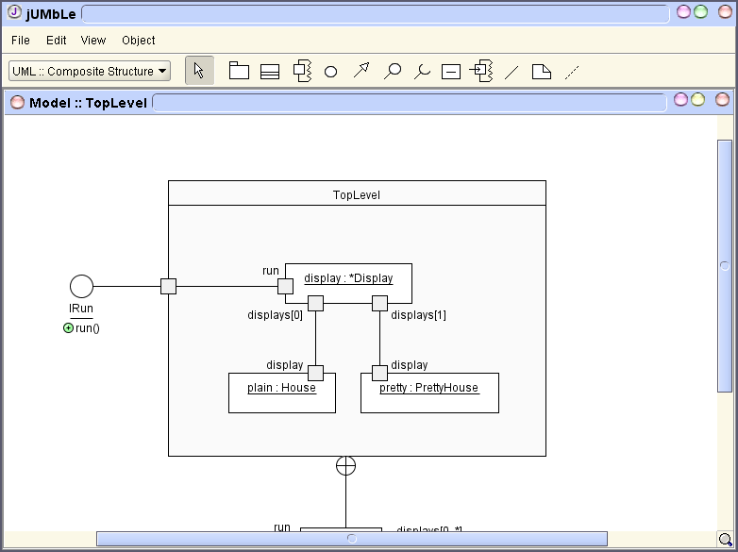
Backbone is (another!) configuration-based system
The interpreter instantiates components to produce a running system
The architecture is explicit and more understandable as a result
But it isn’t enough
  We haven’t solve any issues to do with reuse or evolution…
  The framework team would want to control the component definitions
.bb
Java implementation
(jar files)
.bb
.bb
Backbone
interpreter
= running program

Slide 14
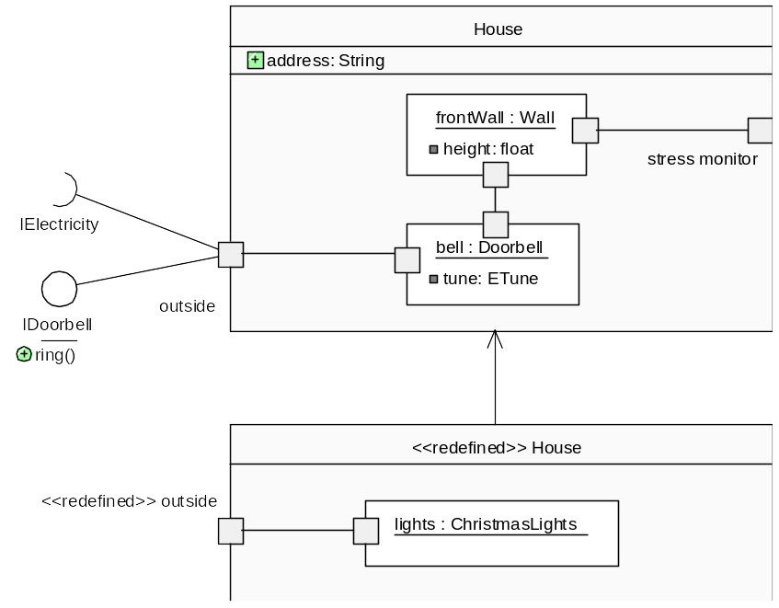
Introducing Redefinition
Mechanism expresses changes to an existing component
  e.g. like a set of instructions expressing changes
  the redefinition is kept separate from the definition
Can also use to define a new component...

Slide 15
Redefinition continued...
Redefinitions of components are kept separately from their definitions
E.g.
framework provides a
House with just a doorbell,
...App1 wants to add an alarm...
App2 doesn’t get affected
But, App1 has just changed the framework
App1
App2
RedefinedHouse.bb
House framework
House.bb

Slide 16
Redefinition Application
Redefinitions are currently applied according to ordering rules
  in order to allow redefinition of an already redefined component, order must be deterministic
Arbitrary structural changes are possible
Deletion, addition and replacement are possible for parts, properties, ports, interfaces and connections

Slide 17
Supporting Evolution...
Arbitrary changes are possible, but we need more...
Evolution must be supported
  Need a way of checking that redefinitions still work after a framework has been evolved
  Need a way to ensure that independently developed plugins / apps will work together, or to detect incompatibility
  What are the vectors of architectural evolution?

Slide 18
Summary
Reuse and Evolution are related topics!
  Reuse often means evolving an architecture
  Framework reuse currently implies compromising the integrity of the framework
Component redefinition allows changes to an architecture to be expressed independently from the architecture itself
  Much greater reuse potential for frameworks
  How can we adjust to address evolution issues?

Slide 19
Using Alloy to Model Redefinitions
Backbone is easily expressed in Alloy
Next: express redefinitions using Order module
  Have already modelled redefinition order
Use model to find and test redefinition patterns
  What types of redefinitions are compatible?
  Patterns of redefinition?

Slide 20
Alloy Models
Show component pictures + loading order from alloy modeller...

Slide 21
Appendix A: jUMbLe

Slide 22
jUMbLe
A UML2 case tool with an internal component architecture (50kloc)
Its own architecture is expressed in UML2 component diagrams, inside the tool
Automatically
generated
Run-time interpretation
Backbone
interpreter
jUMbLe architecture expressed as composite structure diagrams, in jUMbLe
Backbone architecture definition of jUMbLe

Slide 23
jUMbLe’s Architecture
Architecture is a fully componentised set of layered frameworks
Redefinition mechanism allows 3rd party developers to customise fully
  next-generation plugin architecture
  also, a graphical editor for UML2 / Backbone
Backbone is based on jUMbLe’s architectural patterns (= pragmatic focus)

Slide 24
jUMbLe demo?
Give demo of jUMbLe via laptop?

